Slide 1

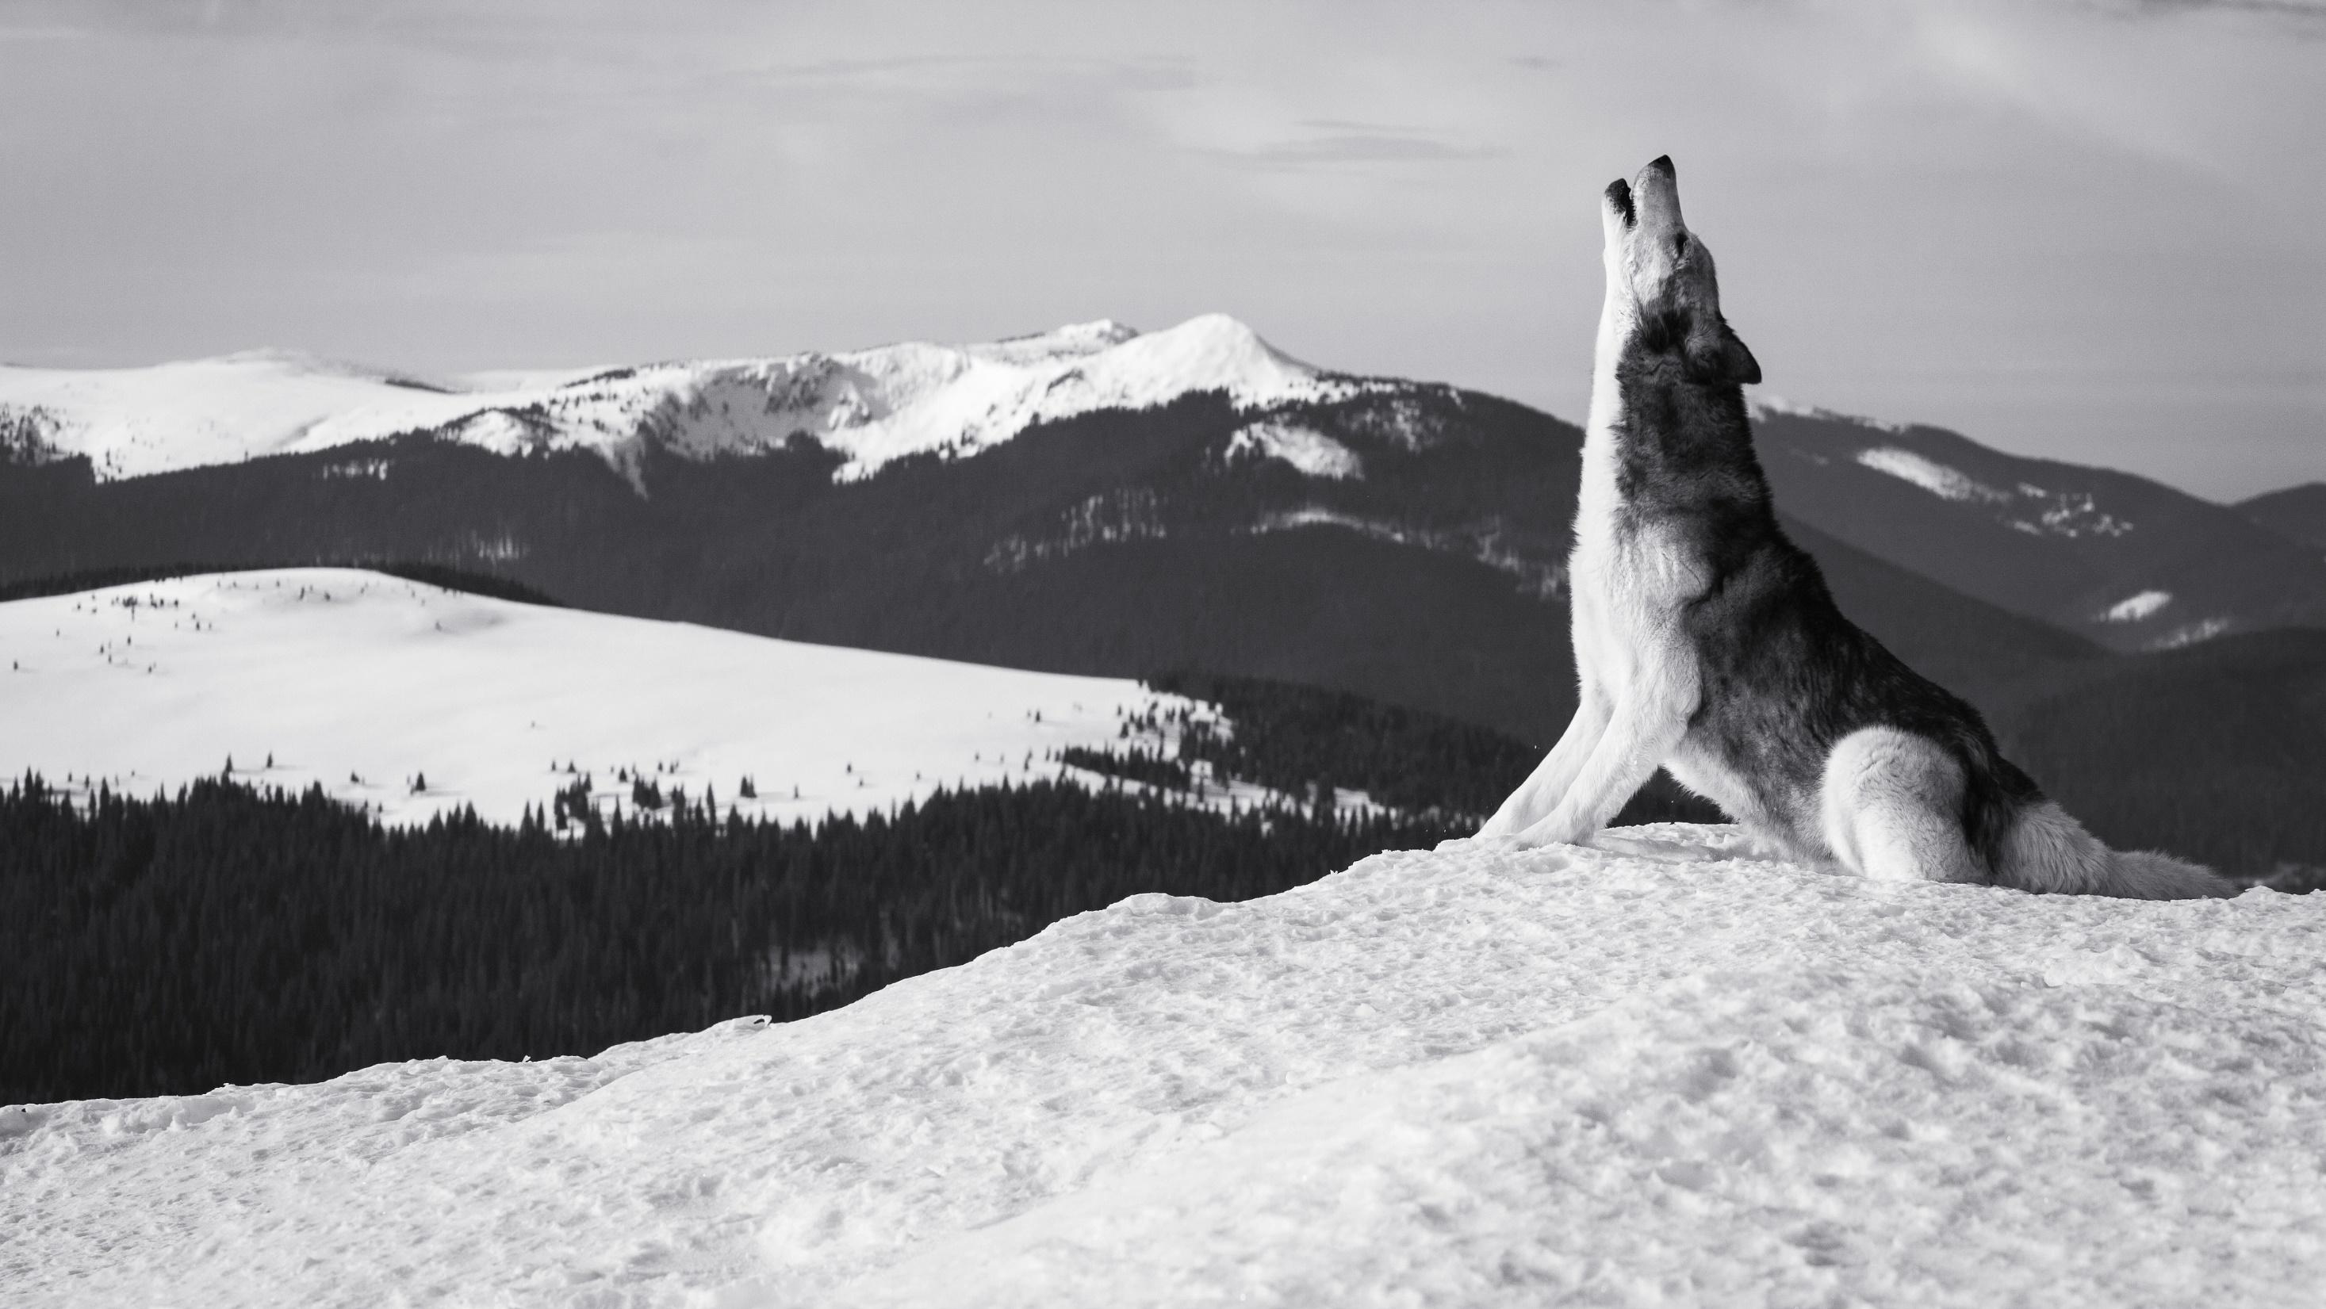




Unit 8
Maheegun My Brother

Slide 2



Lead-in
What movies about human-animal relationship have you watched or heard of?

Slide 3
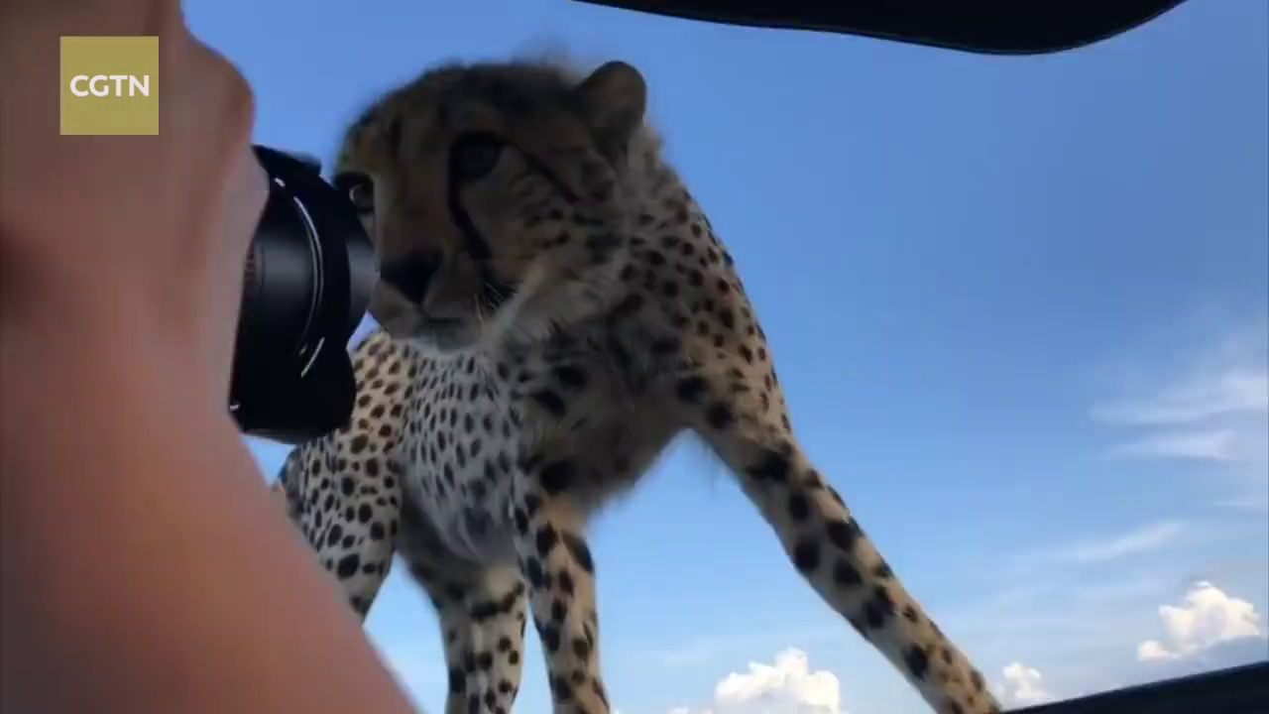
Lead-in
Do you think wild predators(meat-eating animals) are always dangerous? Can predators (e.g. wolves) be kept as pets?

Slide 4

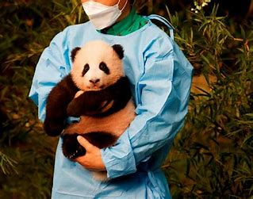
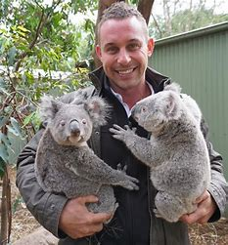
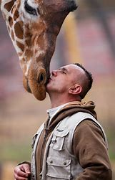
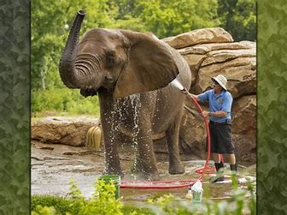
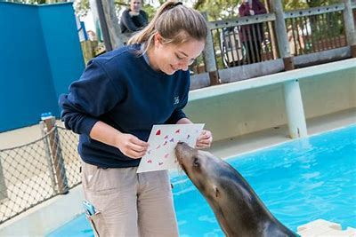
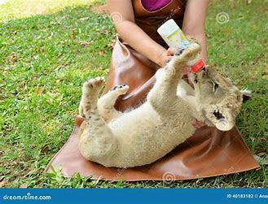
主观题
20分
Suppose you were a zookeeper, which animal would you like to take care of? Give a brief reason.
作答

Slide 5


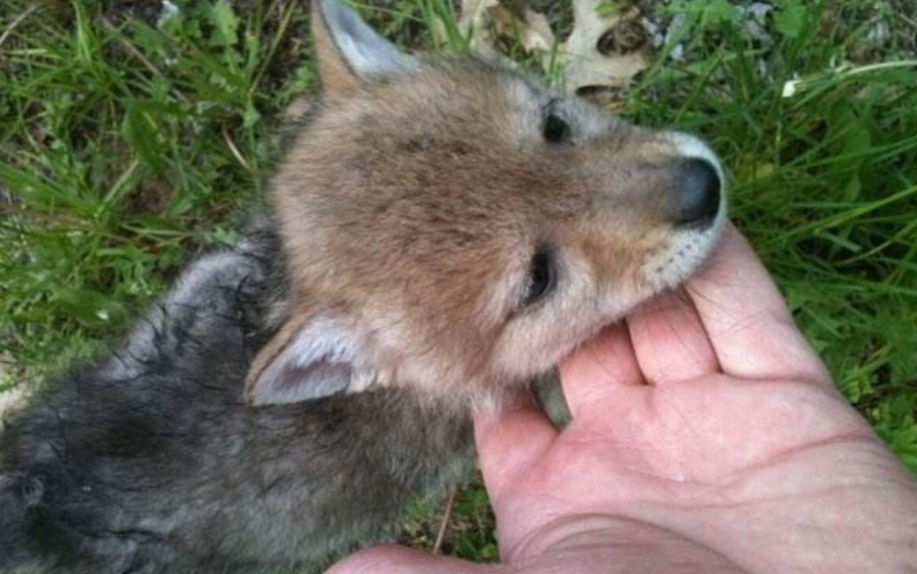
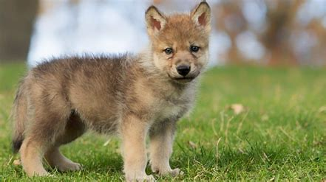
Text Analysis
How the boy and the wolf became friends. (Paras.1-18)
Not that we didn’t have our troubles.(Para.5)
(It is) not that: it does not imply that...; although it is not true that 倒不是说；并不意味着……
1. She loved music but seldom went to concerts—not that she couldn’t afford to.
她热爱音乐，但很少去听音乐会——倒不是因为她买不起票。
2. 他没有参加会议，倒不是因为他很忙。
He didn’t attend the meeting; not that he was busy.

Slide 6
填空题
25分
Summary 1. When Maheegun was found, he was crying and [填空1] (发抖) 2. He was the most [填空2] wolf cub ever. For example, he [填空3] Grandma’s sewing basket. 3. Maheegun and I became [填空4] partners. We hunt grasshoppers and filed mice. 3. When half grown, his puppy-wool coat was replaced with a handsome black [填空5](披风) .
作答

Slide 7
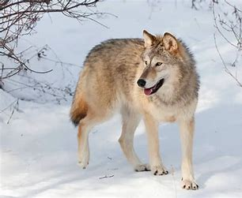
Text Analysis
How the boy and the wolf became friends. (Paras.1-18)
It all served to fog my mind with pleasure so that I forgot my Grandpa’s repeated warnings, and one night left Maheegun unchained. (Para.8)
这一切使我快乐得忘乎所以了，结果一天晚上我把爷爷的再三叮嘱抛到了脑后，没有把莫西干拴起来。
serve (only) to do sth.: 产生…的效果（或结果）
1. The attack was unsuccessful and served only to alert the enemy.
进攻未奏效，反而使敌人警觉起来。
leave + n + v-ed/adj: cause to be or to remain in a particular state
1. He leaves the window open when the weather is fine.
2. 洪水使数百人无家可归。
The flood left hundreds of people homeless.

Slide 8

Text Analysis
How the boy and the wolf became friends. (Paras.1-18)
The following morning in sailed Mrs Yesno, wild with anger, who demanded Maheegun be shot because he had killed her rooster.
Inversion: Mrs Yesno... sailed in.
demand (that) + clause: 虚拟语气 (should) do
(Similar: suggest, order, request, command, advise, desire, insist, prefer)
1. The police demanded that the gunman ________________(放下他的枪).
2. The demonstrators demanded that
the results ______________(被公布).
lay down his gun.
be made public

Slide 9
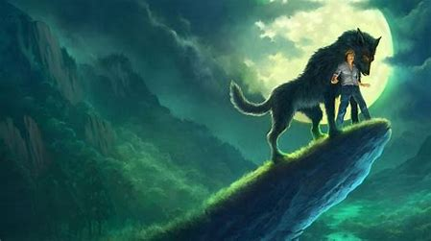
主观题
20分
Make a sentence with “sb. demanded that...”. Pay attention to the subjunctive mood(虚拟语气) of the clause.
e.g.
The UN has demanded that all troops (should) be withdrawn.
联合国已强烈要求撤出所有部队。
The police demanded that he (should) lay down his gun.
警察要求他放下枪。
作答

Slide 10
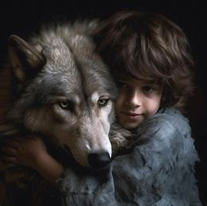
单选题
15分
Why did the boy and his grandpa let Maheegun go?
A
Because he was mischievous and often upset Grandma's sewing basket.
B
Because Mrs. Yesno demanded he be shot.
C
Because the boy wanted to help him adapt to wild life.
D
Because it was time for him to return to his own kind.
提交

Slide 11
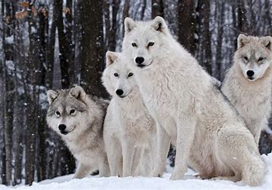
Text Analysis
The dramatic reunion of the boy and the wolf. (Paras.19-35)
I tried to travel west but only to hit the creek again.(Para.24)
only to do sth.: (written) used to show that sth. is surprising or unexpected 结果却……
1. He had tasted freedom only to lose it again.
他刚尝到了自由的甜头，结果却又失去了。
2. He picks up a stone ________________________(结果砸了自己的脚)。
hit: (informal) arrive at, reach
You’ll hit the main road in five minutes’ drive.
再开五分钟你就会到达主干道。
only to drop it on his own toes.

Slide 12
填空题
20分
Explain the underlined words: 1. He was detained by some urgent business. [填空1] a. 耽搁 b. 拘留 2. I stumbled into a creek bed. [填空2] a. 绊倒 b. 偶遇 3. Everything was smothered by the fierce whiteness. [填空3] a. 使窒息 b. 厚厚地覆盖 c.抑制 4. A great white stillness had taken over. [填空4] a. 仍然 b. 寒冷 c.寂静
作答

Slide 13

Text Analysis
The dramatic reunion of the boy and the wolf. (Paras.19-35)
How long I squatted over my dying fire I don’t know.(Para.29)
I don’t know how long I squatted over my dying fire.
inversion (object fronting 宾语前置)
1. For emphasis:
Whatever we have achieved we owe to our Party.
2. For contrast:
The past one can know, but the future one can only feel.
3. For closer connection with previous sentence:
They tell me to give up. That I will never do!

Slide 14

Text Analysis
The reunion of the family. (Paras.36-44)
The cold and loss of blood were taking their toll.(Para.36)
寒冷天气，加上失血太多，给我造成严重的伤害 / 我昏迷过去。
take its/their/a heavy toll on ...: have a bad effect on sb./sth.产生恶果；造成重大损失（或伤亡、灾难等）
1.The recession is taking its toll on the housing markets.
经济衰退使住房市场遭受着重大损失。
2. 多年的劳累和焦虑对他的健康造成很大损害。
Years of hard work and anxiety _______________________.
have taken their toll on his health.

Slide 15


Grammar
Functions of inversion.
a. for emphasis b. closer connection c. long modifier of the subject d. suspense
1. Gone was the puppy-wool coat. In its place was a handsome black mantle. (para. 6)
2. The following morning in sailed Mrs Yesno, wild with anger, who demanded... (para. 8)
3. On the top was the clear outline of a great wolf sitting still... (para. 11)
a, b
c
c, d

Slide 16
Quotes
Animals are such agreeable friends — they ask no questions, they pass no criticisms.
——George Eliot
Animals have hearts that feel, eyes that see, and families to care for, just like you and me.
——Anthony Williams
The animals of the world exist for their own reasons. They were not made for humans any more than black people were made for whites, or women created for men.
——Alice Walker

